Slide 1
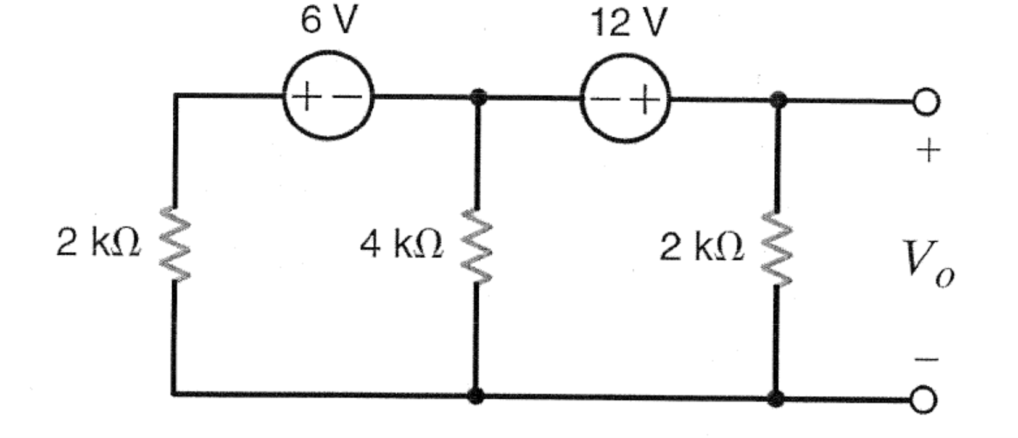
Use Thevenin’s theorem to find V₀ in the circuit below

Slide 2
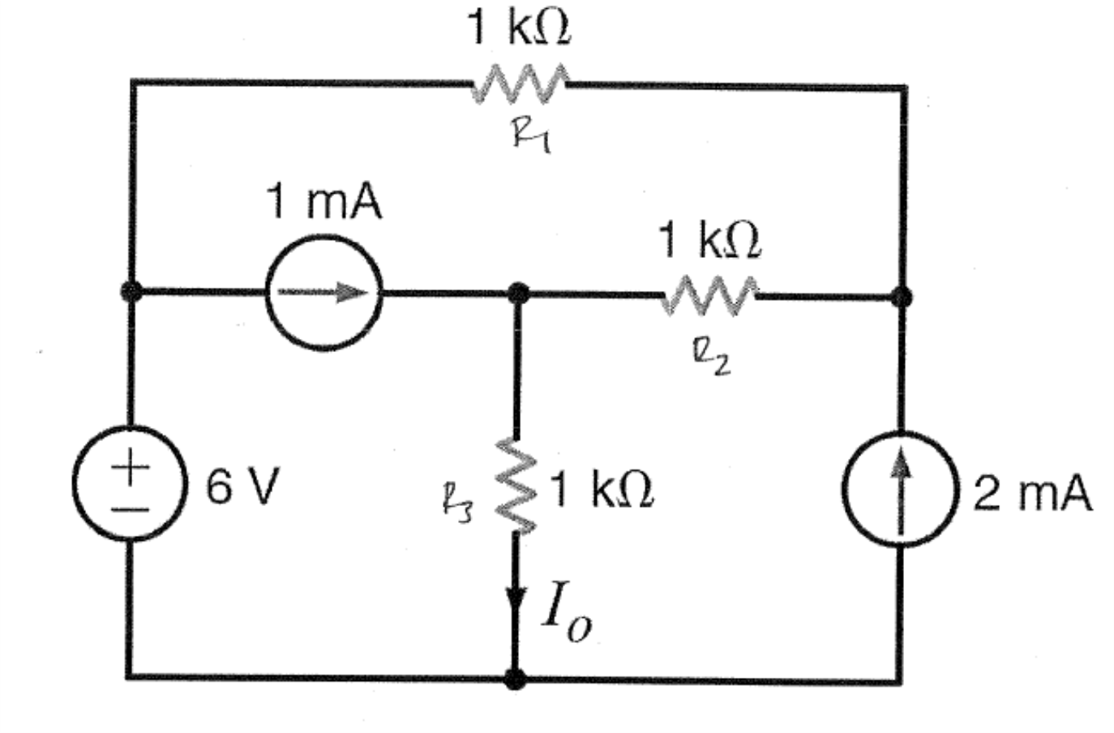
Use Thevenin’s theorem to find I₀ in the circuit below

Slide 3
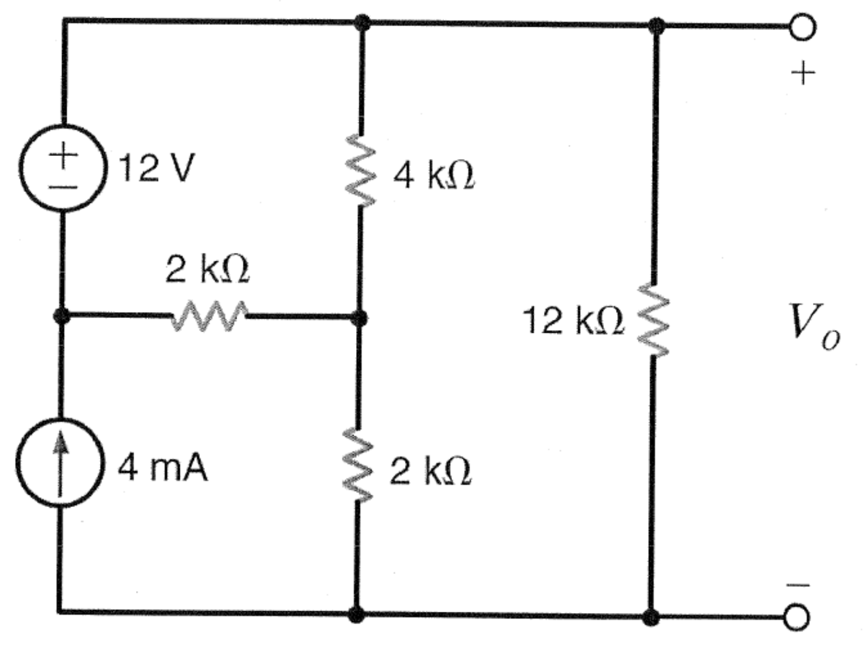
Use Thevenin’s theorem to find V₀ in the circuit below

